Slide 1
Monday, December 12, 2016
Write In Your Agenda:
Write In Your Monitoring Log:
CW:
Stars Powerpoint & Notes
Constellations Powerpoint & Notes
HW:
Study for Seasons Quiz on Thursday 12/15/16.
Response to Warm-Up:
Name three constellations you know.
You will need:
Pencil
New Monitoring Log

Slide 2
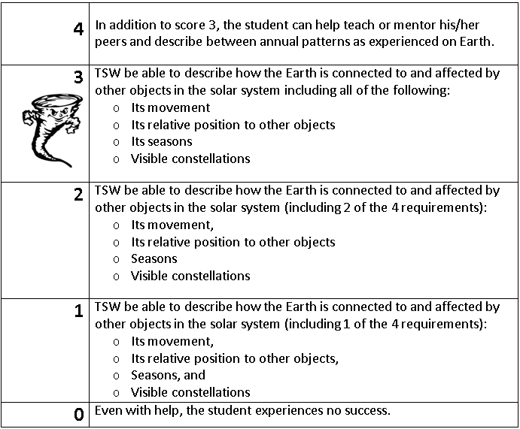
Learning Goal and Scale
TSW be able to describe how the Earth is connected to and affected by other objects in the solar system (including its movement, its relative position to other objects, its seasons, and visible constellations).

